Slide 1


UrbanCity Weather Report
Weather Prediction & Report

Slide 2

Problem Statement

Slide 3
Weather impacts everything from daily life to major industries. Farmers depend on forecasts to protect crops, travelers plan around weather conditions, and emergency responders prepare for disasters. However, traditional methods often fail to capture complex temperature patterns, leading to inaccurate predictions and costly disruptions.
A smarter, data-driven approach is needed—one that not only improves temperature forecasting but also provides interactive insights to help users spot trends, identify anomalies, and make informed decisions.

Slide 4
Solution Offered

Slide 5
We developed a smart weather prediction app using Streamlit, XGBoost, and Gemini API to provide accurate forecasts, insightful analysis, and interactive visualizations, making weather interpretation easier.
Here’s what it offers:
User-Friendly Interface – A clean, interactive Streamlit app that lets users input data, view predictions, and explore trends effortlessly.
Accurate Forecasting – Powered by XGBoost, the model analyzes historical weather data to predict temperature trends with high precision, capturing patterns that traditional methods often miss.
Real-Time Weather Insights – With Gemini API, the app enriches predictions with live weather data, offering contextual updates and explanations to better understand temperature changes.
Visualizations – Forecasts are presented through intuitive charts and graphs, allowing users to track trends, analyze fluctuations, and compare predictions with past data.

Slide 6
Deployment

Slide 7
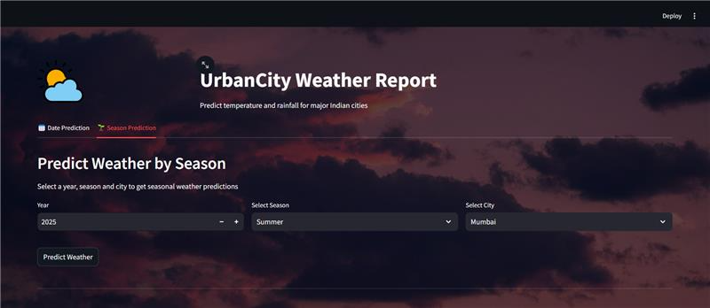
User-Friendly Interface

Slide 8
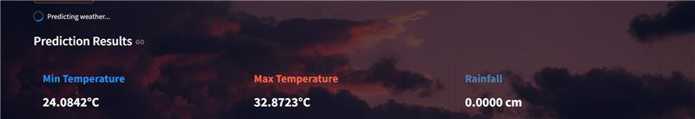
Accurate Forecasting

Slide 9
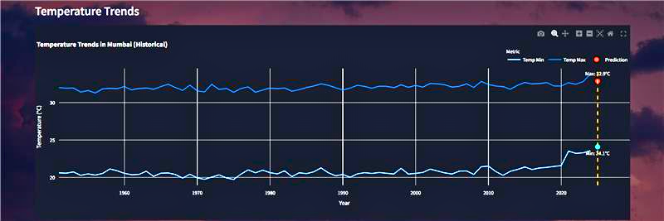
Insights & Visualization

Slide 10
Thank You

